Slide 1
Question Generation:
How to ask questions?
Dong Li 22 Nov 2020

Slide 2

OUTLINE
1
Introduction
2
Models
3
Conclusion

Slide 3
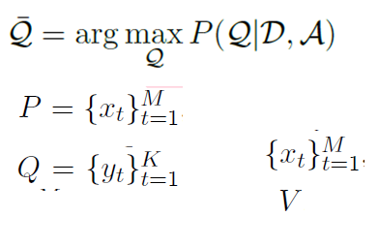

Introduction
QG：asking good questions based on an answer and relevant context
QG Application: QA; Dialogue; Education
QG task:
QG Metrics:
automatic evaluation: BLEU 1-4; METEOR; ROUGE-L;
perplexity; distinct
human evaluation: Fluency; Relevance; Complexity; Answerability
(1)
(2)

Slide 4
Introduction
QG challenge:
How to ask question cross long text?
How to model paragraph-level S2S QG model?
How to ask human-like questions ?
How to generate semantic-level and reasonable questions?

Slide 5
Models
QG Method Graph
Rule-based QG
Answer-unaware
QG Method
S2S QG
Pointer-Generator
Multi-task learning
Answer-aware
GNN
LM
QG&QA
……

Slide 6
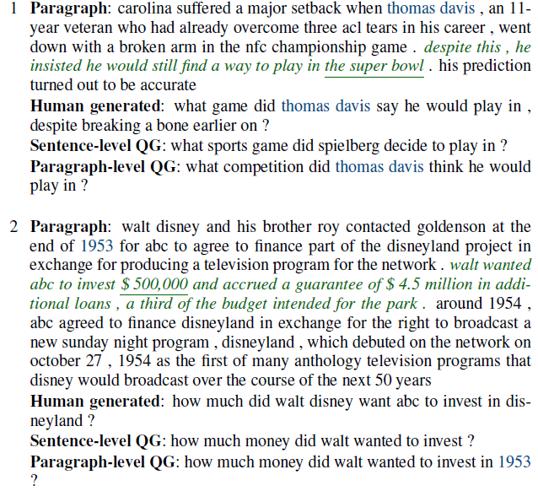
Paragraph-level Neural Question Generation with Maxout Pointer and Gated Self-attention Networks(ACL 2018)
Pointer-Generator QG
Task
take the whole paragraph as context for high quality paragraph-level QG
solve the problem of leveraging long text for S2S model in QG
Method:
sentence-level QG
a maxout pointer mechanism with gated self-attention encoder

Slide 7
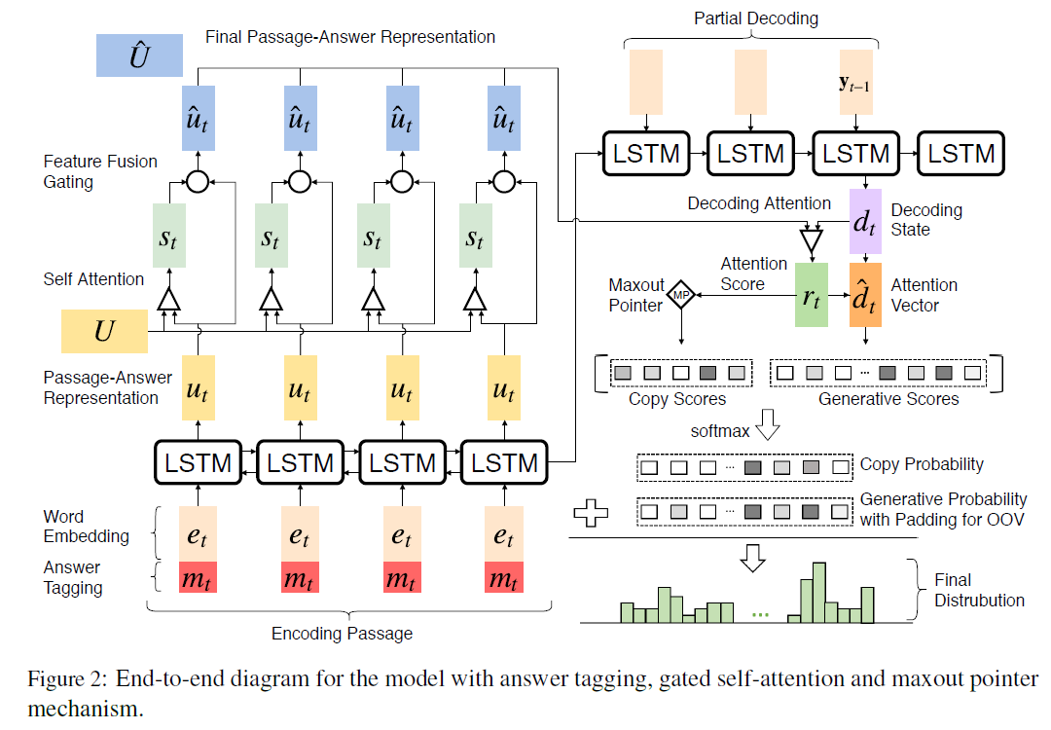
Paragraph-level Neural Question Generation with Maxout Pointer and Gated Self-attention Networks(ACL 2018)
Pointer-Generator QG
Framework
Passage and Answer Encoding
Decoding with Attention and Maxout Pointer

Slide 8

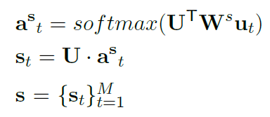
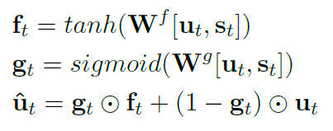
Paragraph-level Neural Question Generation with Maxout Pointer and Gated Self-attention Networks(ACL 2018)
Pointer-Generator QG
Passage and Answer Encoding
Answer Tagging
Gated Self-attention
Encode passage-answer input with self matching representation
Combine passage-answer input representation using a feature fusion gate
; new self-matching representation
; self-matching representation

Slide 9
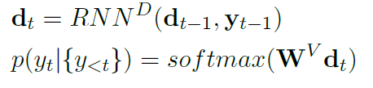
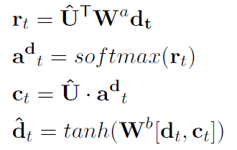
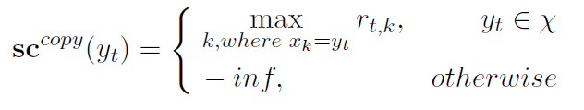
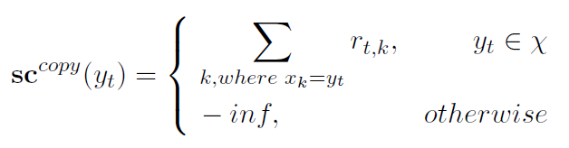
Paragraph-level Neural Question Generation with Maxout Pointer and Gated Self-attention Networks(ACL 2018)
Pointer-Generator QG
Decoding with Attention and Maxout Pointer
RNN
Luong Attention Mechanism (15’s)
Copy Mechanism or Pointer Network
Maxout Pointer Mechanism
reduce the repetition in S2S model

Slide 10
Paragraph-level Neural Question Generation with Maxout Pointer and Gated Self-attention Networks(ACL 2018)
Pointer-Generator QG
Experiments
Dataset
SQuAD; MS MARCO
Metrics
BLEU 1-4; METEOR; ROUGE-L

Slide 11
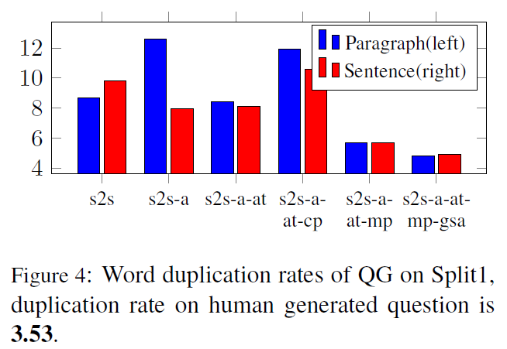
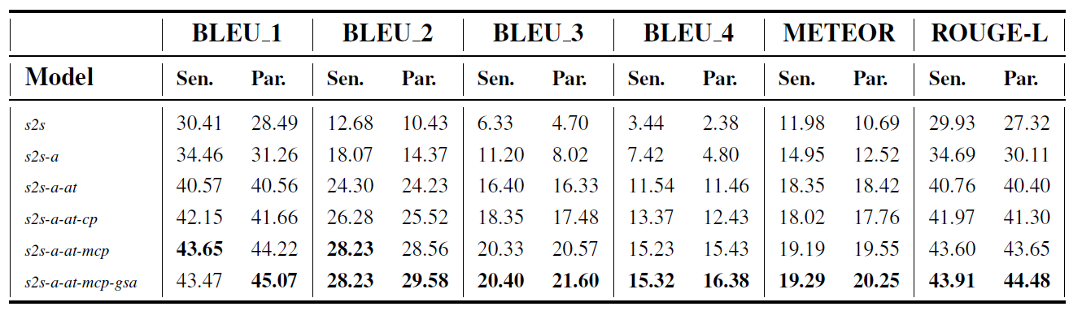
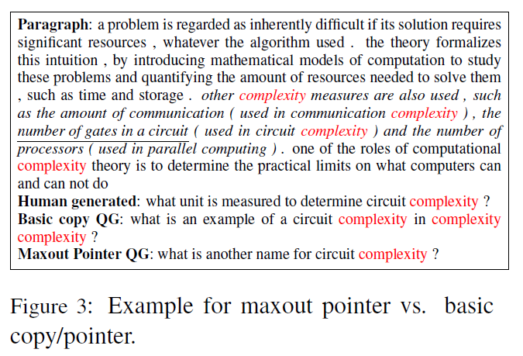
Paragraph-level Neural Question Generation with Maxout Pointer and Gated Self-attention Networks(ACL 2018)
Pointer-Generator QG
Experiments
Results and Analysis
Paragraph-level QG > sentence-level QG

Slide 12
Multi-task QG
Multi-Task Learning with Language Modeling for Question Generation (EMNLP 2019)
Task
answer-aware questions generation
enable the encoder to learn a better representation of the input sequence
guide the decoder to generate more coherent and fluent questions
Method:
multi-task learning structure
attention-based pointer-generator model
language modeling as an auxiliary task

Slide 13
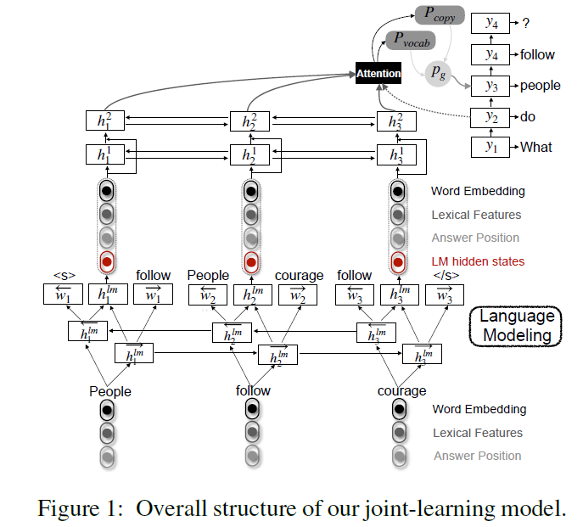
Multi-task QG
Multi-Task Learning with Language Modeling for Question Generation (EMNLP 2019)
Framework
Feature-enriched Pointer Generator
feature-rich encoder (Bi-LSTM)
concatenates the word embedding, answer position embedding and lexical feature embedding(POS, tags, NER tags, and word case)
attention-based decoder (LSTM)
two-layer feed-forward network
Language Modeling

Slide 14
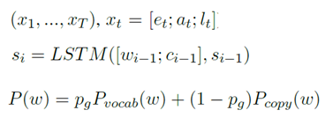
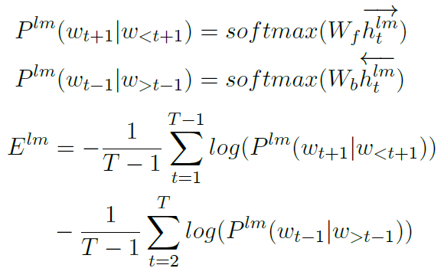

Multi-task QG
Multi-Task Learning with Language Modeling for Question Generation (EMNLP 2019)
Framework
Feature-enriched Pointer Generator (high-level task)
feature-rich encoder (Bi-LSTM)
concatenates the word embedding, answer position embedding and lexical feature embedding(POS tags, NER tags, and word case)
attention-based decoder (LSTM)
two-layer feed-forward network
Language Modeling (low-level task)
Multi-task Learning

Slide 15
Multi-task QG
Multi-Task Learning with Language Modeling for Question Generation (EMNLP 2019)
Experiments
Dataset
SQuAD ; MARCO
Metrics
BLEU 1-4; perplexity; distinct
matching; fluency; relevance

Slide 16
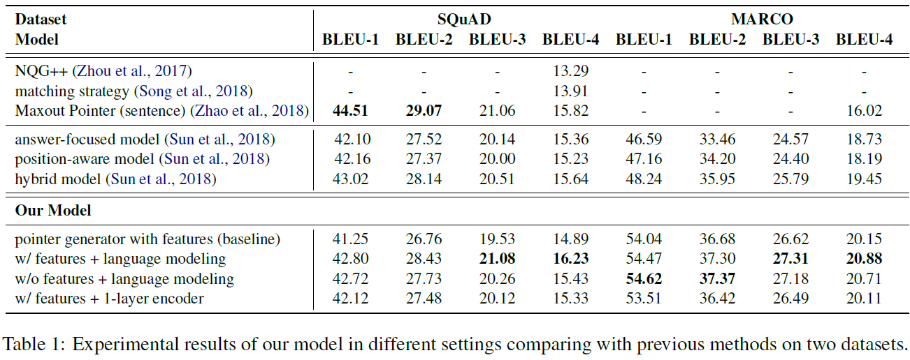
Multi-task QG
Multi-Task Learning with Language Modeling for Question Generation (EMNLP 2019)
Experiments
Results and Analysis

Slide 17
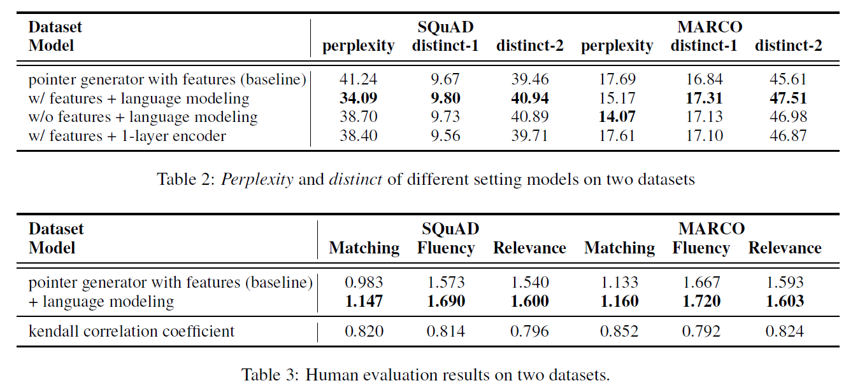
Multi-task QG
Multi-Task Learning with Language Modeling for Question Generation (EMNLP 2019)
Experiments
Results and Analysis

Slide 18
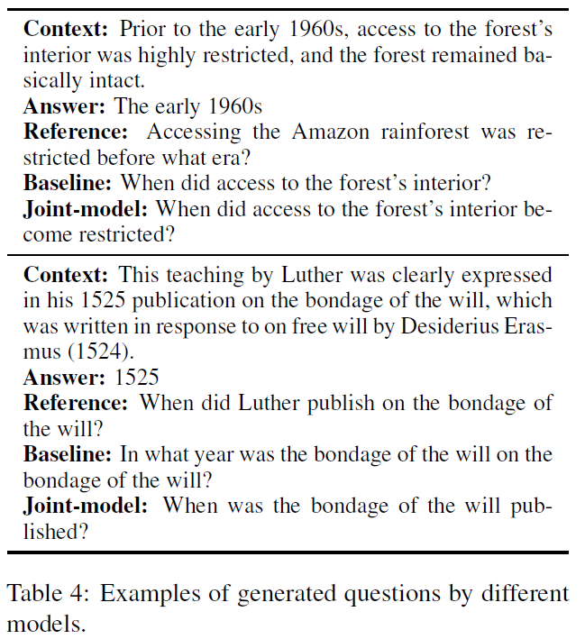
Multi-task QG
Multi-Task Learning with Language Modeling for Question Generation (EMNLP 2019)
Experiments
Results and Analysis

Slide 19
Multi-task QG
Question-type Driven Question Generation (EMNLP 2019)
Task
solve the mismatch issue between question type and answer
For example:
question type: “How”
answer : a personal name
Method:
a unified model to predict the question type and to generate questions simultaneously

Slide 20
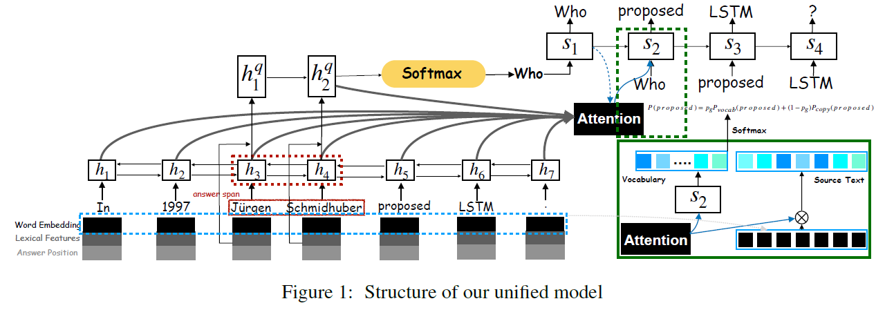
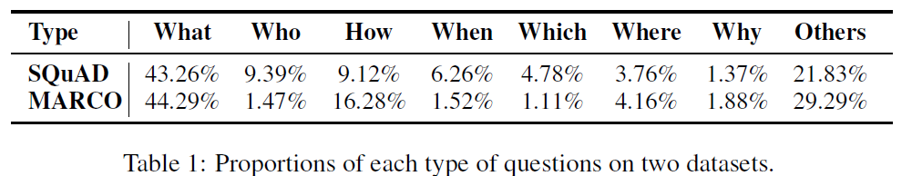
Multi-task QG
Question-type Driven Question Generation (EMNLP 2019)
Framework
Feature-rich Encoder
feature-rich encoder (Bi-LSTM)
concatenates the word embedding, answer position embedding and lexical feature embedding(POS tags, NER tags, and word case)
Question Type Prediction (LSTM)
Unified Attention-based Decoder
challenge: the data distribution on different types is quite unbalanced
Notes:
不同类型的问题在句法和语义 也不相同，因此为了更好地生成可推理的问题，有必要预测问题类型。78%的问题都由疑问词开始的

Slide 21
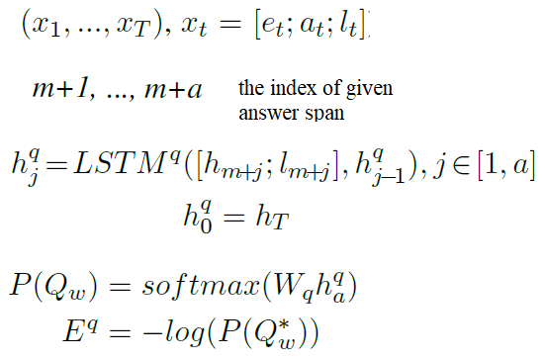
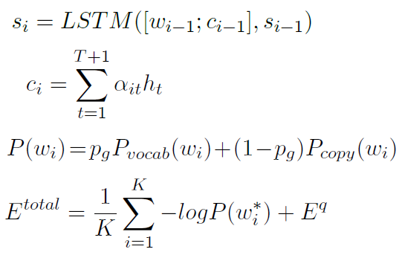
Multi-task QG
Question-type Driven Question Generation (EMNLP 2019)
Framework
Feature-rich Encoder
feature-rich encoder (Bi-LSTM)
concatenates the word embedding, answer position embedding and lexical feature embedding(POS tags, NER tags, and word case)
Question Type Prediction
Unified Attention-based Decoder
Notes:
不同类型的问题在句法和语义 也不相同，因此为了更好地生成可推理的问题，有必要预测问题类型。78%的问题都由疑问词开始的

Slide 22
Multi-task QG
Question-type Driven Question Generation (EMNLP 2019)
Experiments
Dataset
SQuAD; MARCO
Metrics
BLUE 1-4

Slide 23
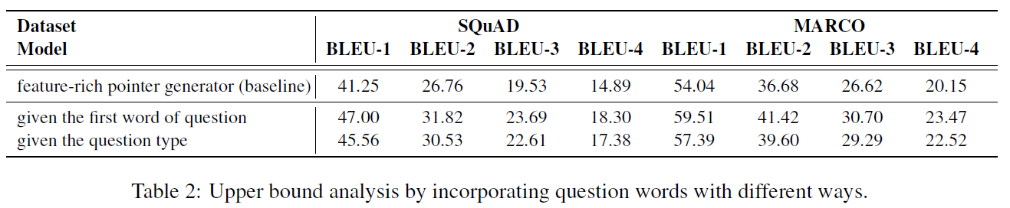
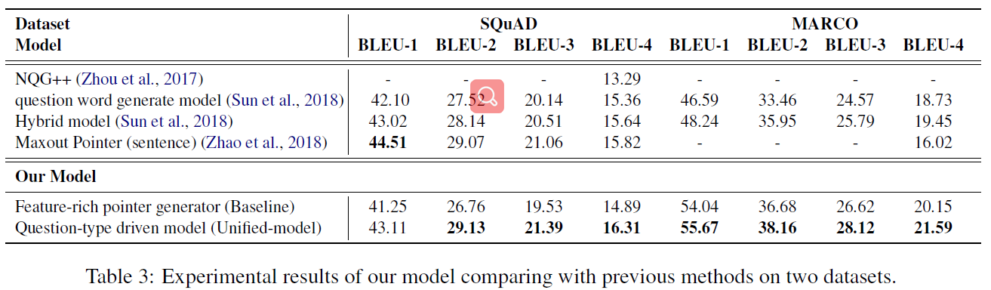
Multi-task QG
Question-type Driven Question Generation (EMNLP 2019)
Experiments
Results and Analysis

Slide 24
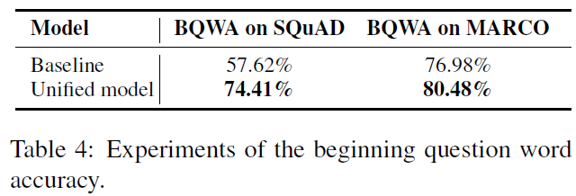
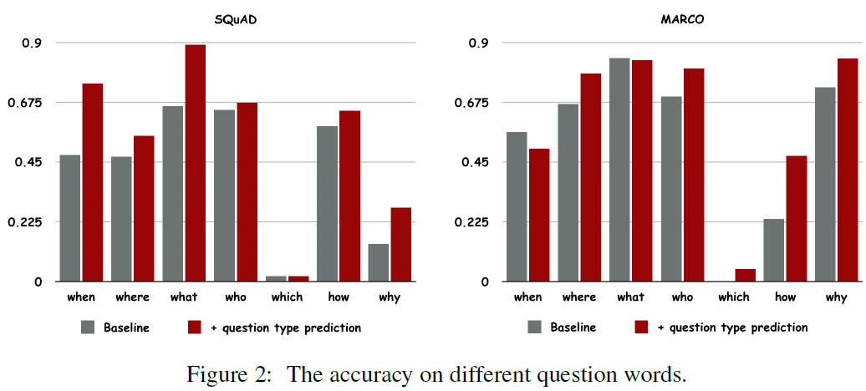
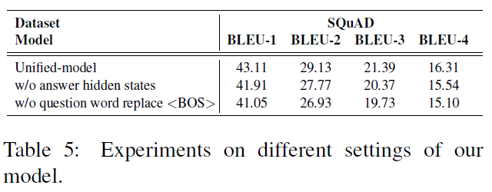
Multi-task QG
Question-type Driven Question Generation (EMNLP 2019)
Experiments
Results and Analysis

Slide 25
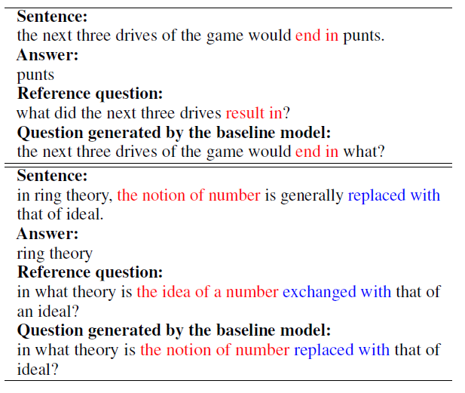
Multi-task QG
How to Ask Good Questions? Try to Leverage Paraphrases(ACL 2020)
Task
the challenge task is how to ask good questions
ask questions of the same meaning but with diverse expressions
incorporate paraphrase knowledge into QG to generate human-like questions
Method:
a two-hand hybrid model with a self-built paraphrase resource (by back-translation approach)
multi-task learning with sentence-level PG and QG
a new min-loss function for diversity training
same meaning, different words

Slide 26
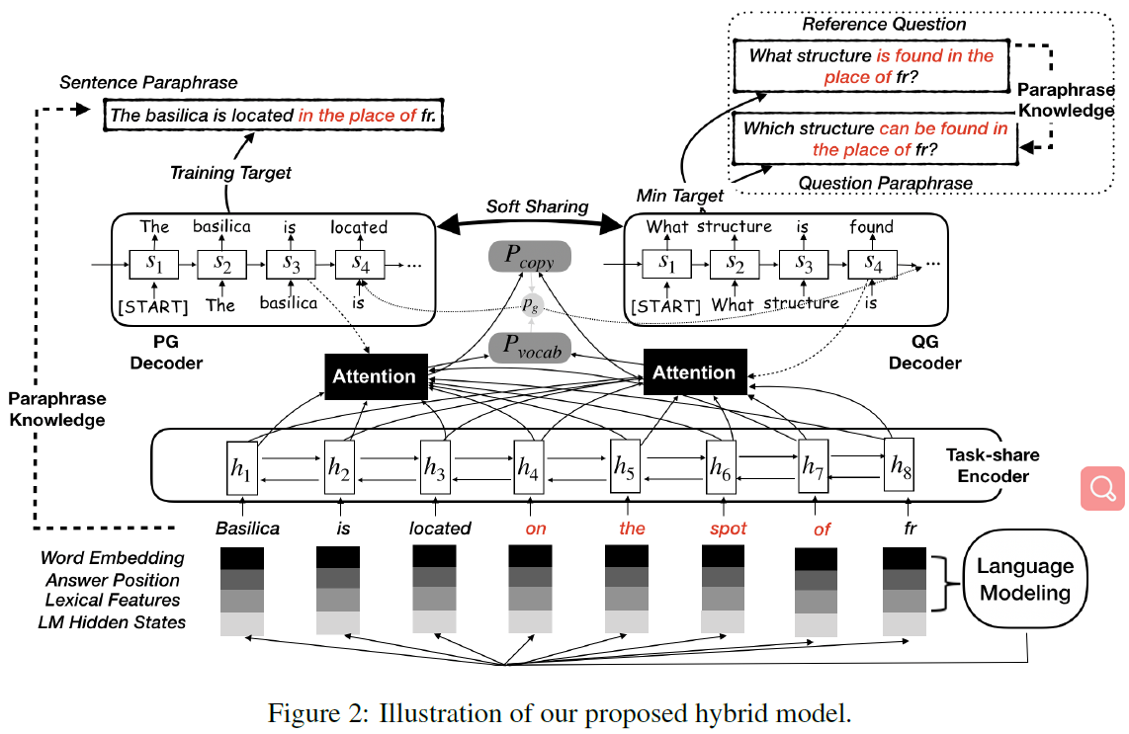
Multi-task QG
How to Ask Good Questions? Try to Leverage Paraphrases(ACL 2020)
Framework
Baseline Models
Feature-enriched Pointer-generator
Language Modeling Enhanced QG
Paraphrase Expansion
a simple back-translation method
Google Translate
Multi-task Learning with Paraphrase Generation
QG (main task)+ PG (auxiliary task)
Soft Sharing Strategy
Diversity Training with Min-loss Function
Hybrid Model

Slide 27
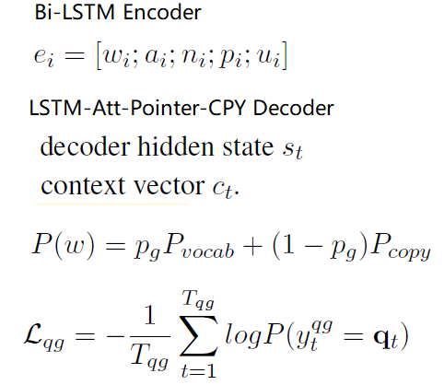
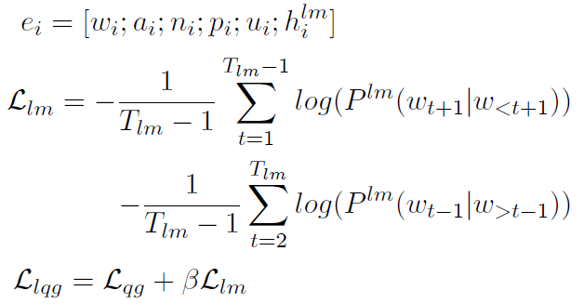
Multi-task QG
How to Ask Good Questions? Try to Leverage Paraphrases(ACL 2020)
Framework
Baseline Models
Feature-enriched Pointer-generator
Language Modeling Enhanced QG
Paraphrase Expansion
a simple back-translation method
Google Translate
Multi-task Learning with Paraphrase Generation
QG (main task)+ PG (auxiliary task)
Soft Sharing Strategy
Diversity Training with Min-loss Function
Hybrid Model

Slide 28

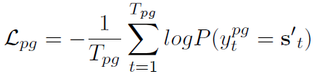

Multi-task QG
How to Ask Good Questions? Try to Leverage Paraphrases(ACL 2020)
Framework
Baseline Models
Feature-enriched Pointer-generator
Language Modeling Enhanced QG
Paraphrase Expansion
a simple back-translation method
Google Translate
Multi-task Learning with Paraphrase Generation
QG (main task)+ PG (auxiliary task)
Soft Sharing Strategy
Diversity Training with Min-loss Function
Hybrid Model

Slide 29
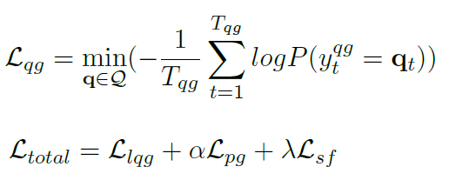
Multi-task QG
How to Ask Good Questions? Try to Leverage Paraphrases(ACL 2020)
Framework
Baseline Models
Feature-enriched Pointer-generator
Language Modeling Enhanced QG
Paraphrase Expansion
a simple back-translation method
Google Translate
Multi-task Learning with Paraphrase Generation
Auxiliary PG Task
Soft Sharing Strategy
Diversity Training with Min-loss Function
Hybrid Model

Slide 30
Multi-task QG
How to Ask Good Questions? Try to Leverage Paraphrases(ACL 2020)
Experiments
Dataset
SQuAD; MARCO
Metrics
BLEU 1-4; METEOR; distinct
Fluency; Relevancy; Answerability

Slide 31
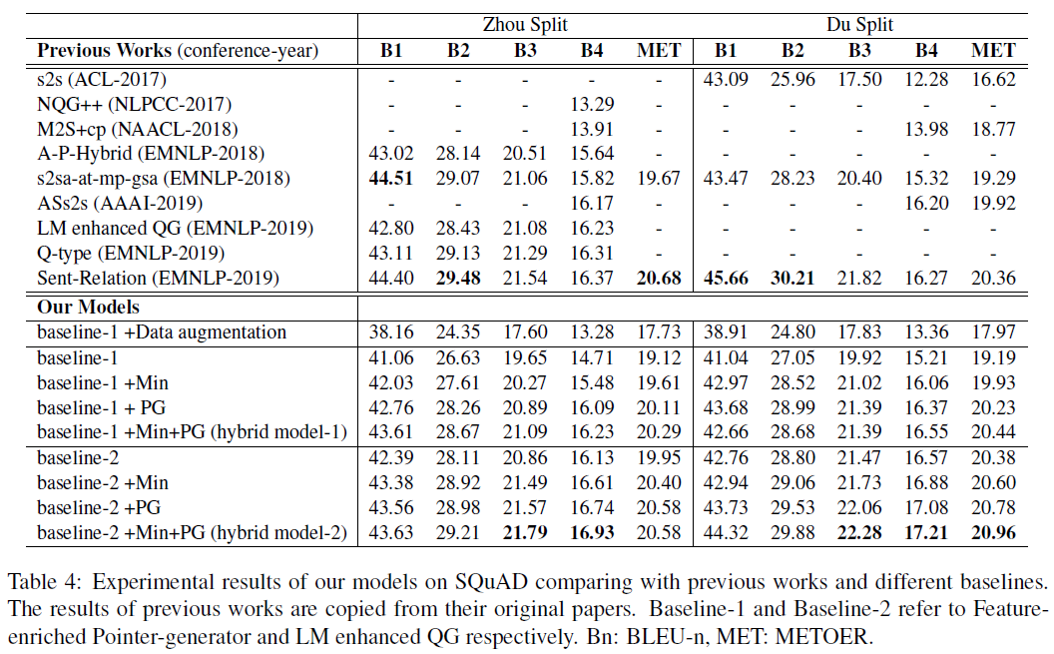
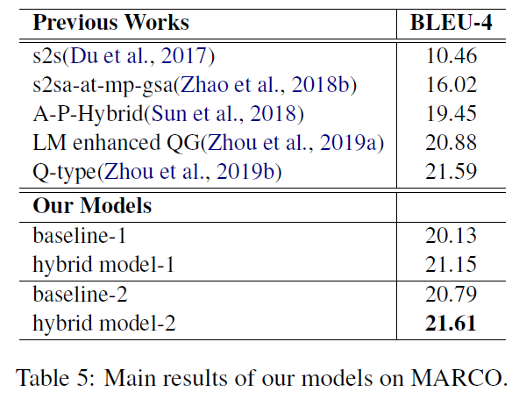
Multi-task QG
How to Ask Good Questions? Try to Leverage Paraphrases(ACL 2020)
Experiments
Results and Analysis

Slide 32
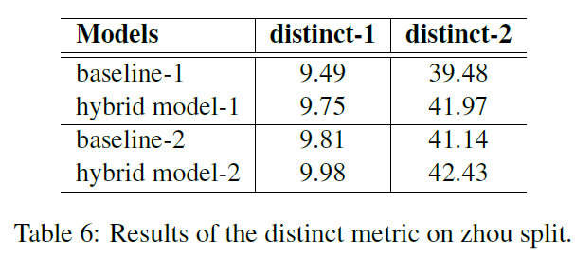
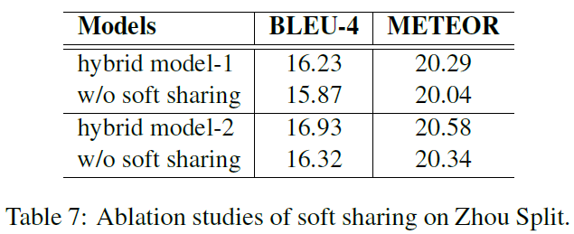
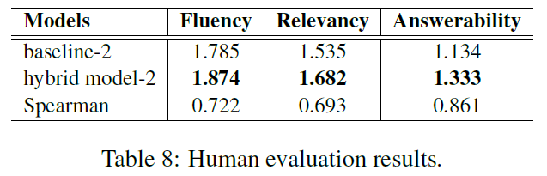
Multi-task QG
How to Ask Good Questions? Try to Leverage Paraphrases(ACL 2020)
Experiments
Results and Analysis

Slide 33
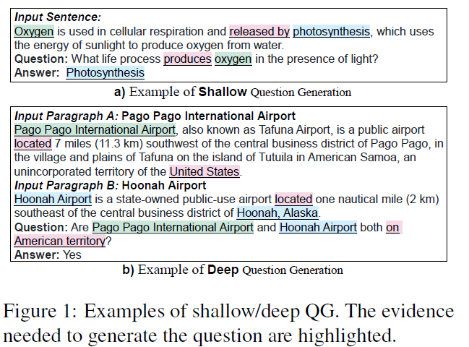
GNN-QG
Semantic Graphs for Generating Deep Questions (AAAI 2020)
Task
Deep Question Generation (DQG): generate complex questions that require reasoning over multiple pieces of information of the input passage
Method:
Semantic graph (Att-GGNN)
Joint Learning (Content Selection+Question Decoding)

Slide 34
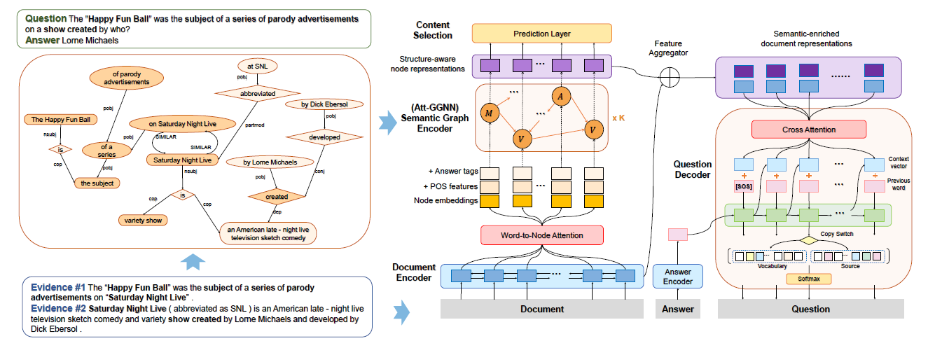
GNN-QG
Semantic Graphs for Generating Deep Questions (AAAI 2020)
Framework
semantic graph construction
builds the DP-based or SRL-based semantic graph
semantic-enriched document representation
Attention-enhanced Gated Graph Neural Network (Att-GGNN)
joint-task question generation
generates deep questions via joint training of node-level content selection and word-level question decoding

Slide 35
GNN-QG
Semantic Graphs for Generating Deep Questions (AAAI 2020)
Semantic Graph Construction
SRL-based Semantic Graph
identify what semantic relations hold among a predicate and its associated participants and properties
extract predicate-argument tuples via SRL toolkits
add inter-tuple edges between nodes from different tuples
DP- based Semantic Graph
removing unimportant constituents and merging consecutive nodes that form a complete semantic unit
construct dependency parse tree with biaffine attention model
add inter-tree edges between similar nodes from different parse trees
model more fine-grained and sparse semantic relations

Slide 36
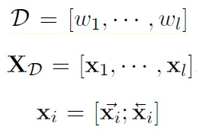
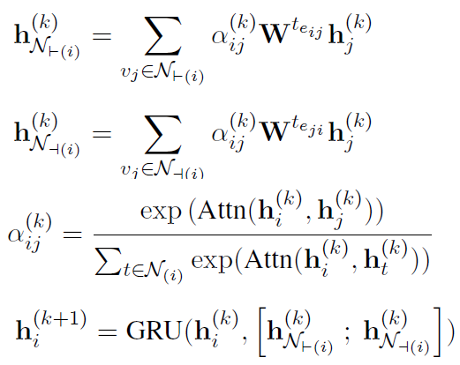
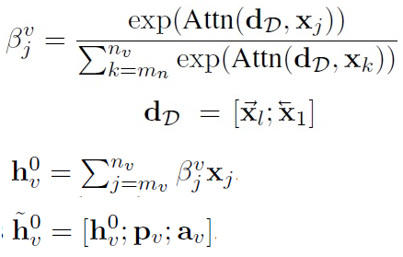
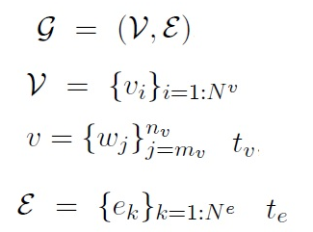
GNN-QG
Semantic Graphs for Generating Deep Questions (AAAI 2020)
Semantic-Enriched Document Representations
Document Encoding
Bi-GRU
Graph Encoding
Att-GGNN
Notes:
Word2node Att不仅要捕获其组成部分的含义，还要捕获整个文档的语义。

Slide 37


GNN-QG
Semantic Graphs for Generating Deep Questions (AAAI 2020)
Semantic-Enriched Document Representations
Feature Aggregation
a simple matching-based strategy
semantic-enriched representation
provides the following important information
semantic information
phrase information
keyword information
Notes:
Word2node Att不仅要捕获其组成部分的含义，还要捕获整个文档的语义。

Slide 38
GNN-QG
Semantic Graphs for Generating Deep Questions (AAAI 2020)
Joint Task Question Generation
Joint Training
Question Decoding
GRU-attn-cpy-cover model
Content Selection
a node classification task
help the model to identify the question-worthy parts that form a proper reasoning chain in the semantic graph
jointly train these two tasks with weight sharing on the input representations.
Notes:
Word2node Att不仅要捕获其组成部分的含义，还要捕获整个文档的语义。

Slide 39
GNN-QG
Semantic Graphs for Generating Deep Questions (AAAI 2020)
Experiments
Dataset
HotpotQA
Metrics
BLEU 1-4; METEOR; ROUGE-L
Fluency; Relevance; Complexity

Slide 40
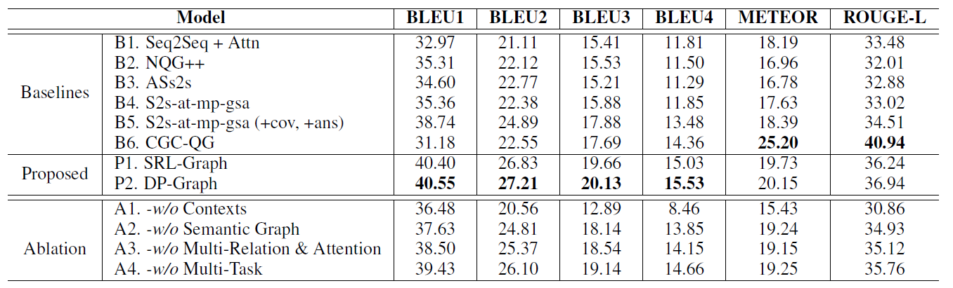
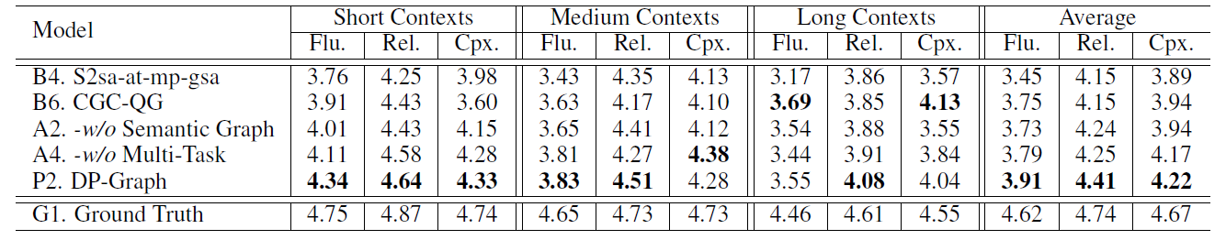
GNN-QG
Semantic Graphs for Generating Deep Questions (AAAI 2020)
Experiments

Slide 41
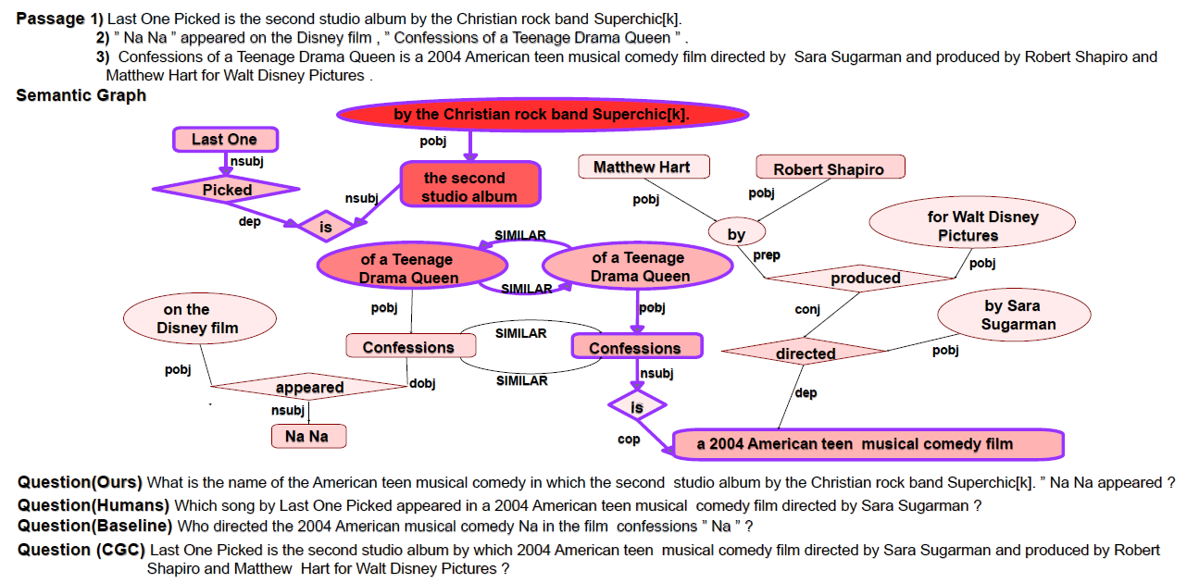
GNN-QG
Semantic Graphs for Generating Deep Questions (AAAI 2020)
Experiments

Slide 42
Conclusion
Feature Works:
introduce fruitful semantic information or explore more advanced semantic representations
generate more fluent and reasonable questions with diverse expressions
try to ask proper answer-unaware questions

Slide 43
Thanks

